Slide 1


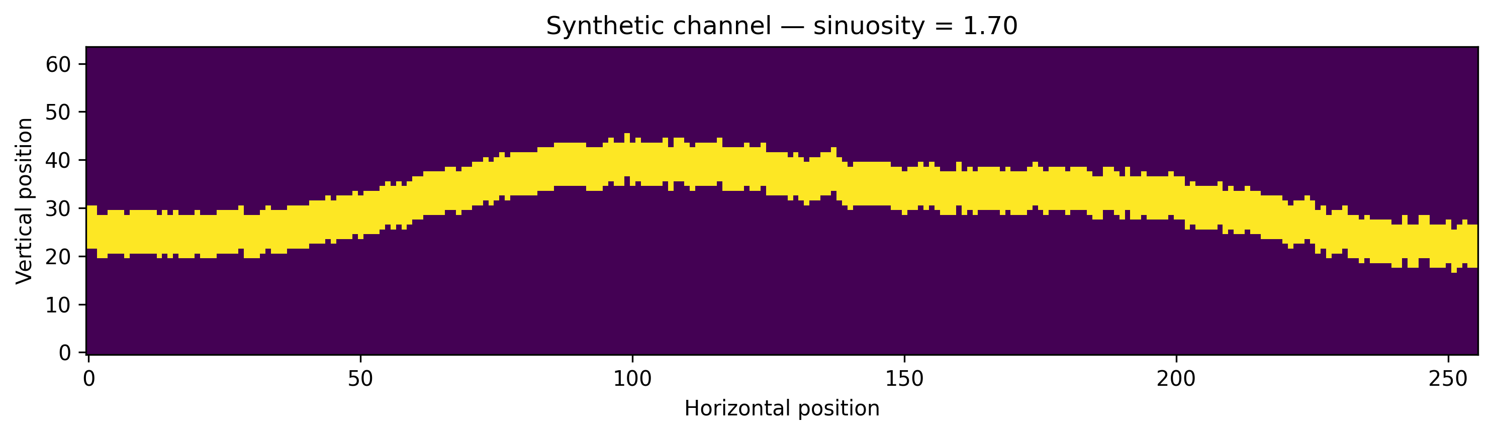
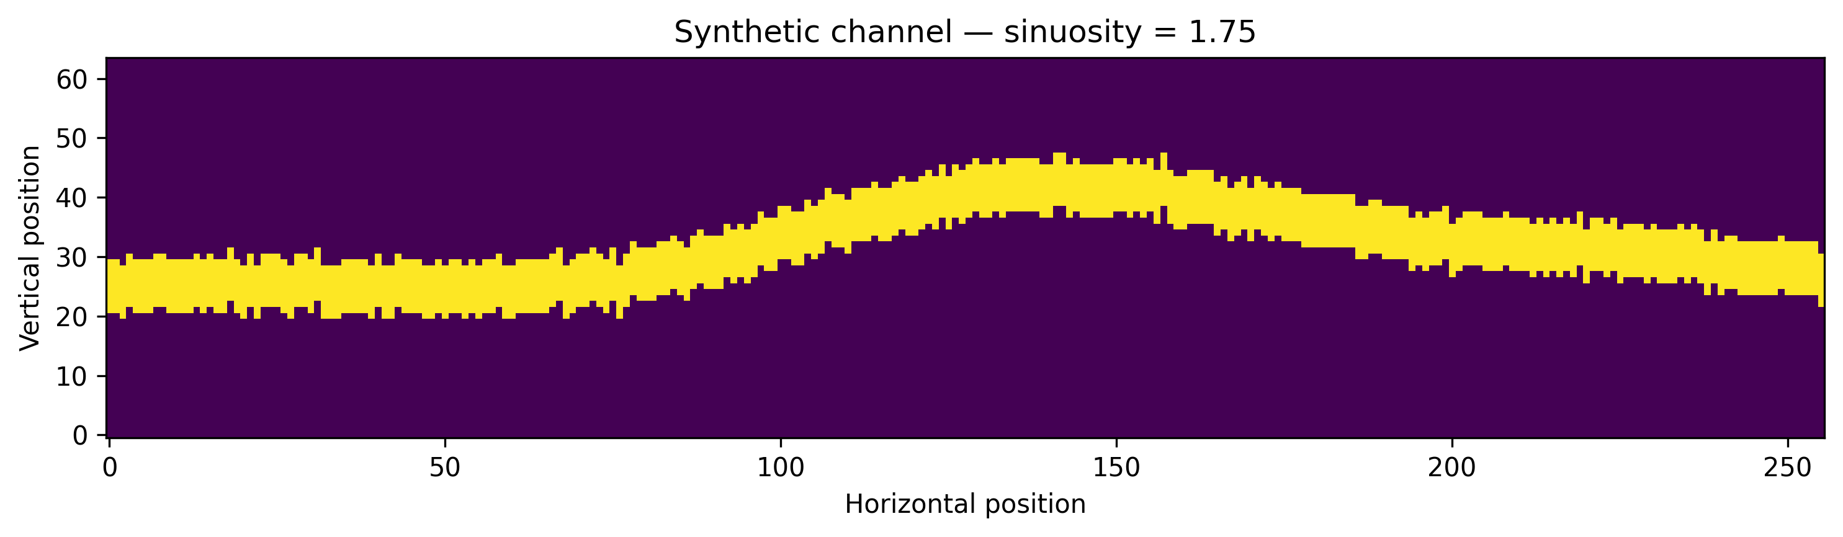
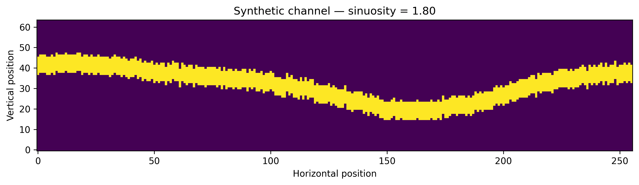
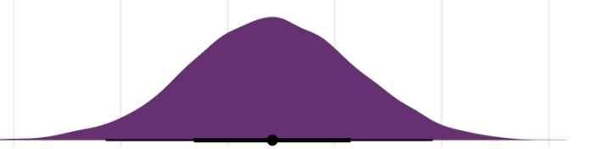
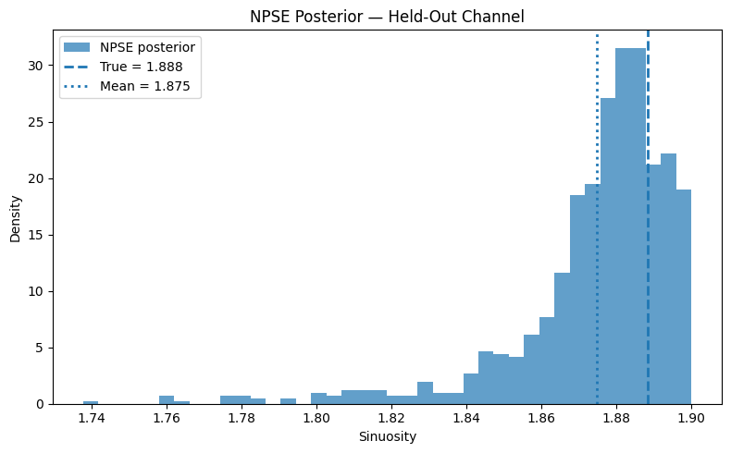
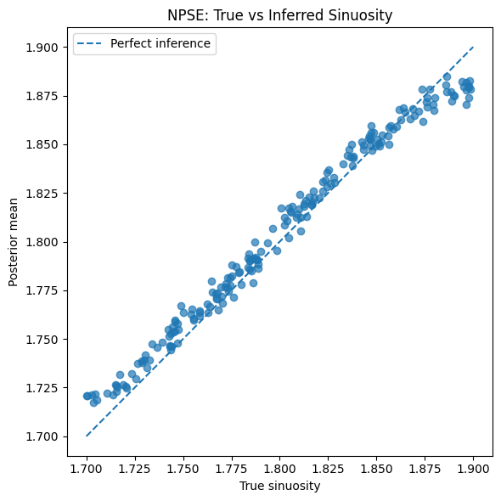
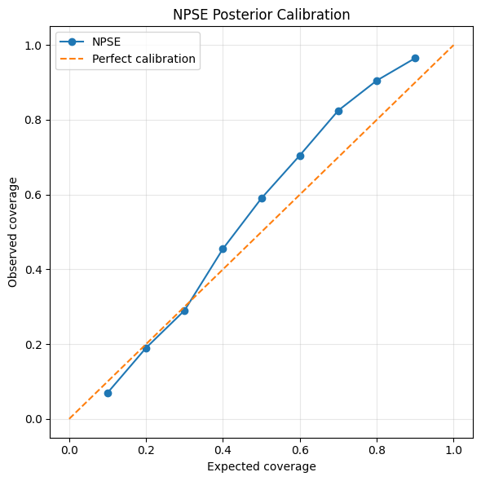
Applying SBI to Geological Modelling
Heebah Saleem¹, Sergey Alyaev², Nello Blaser¹, Kristian Fossum²
¹University of Bergen | ²NORCE
1. Motivation
2. Research Question
3. Contribution
Subsurface geological parameter e.g. channel sinuosity, are critical for geosteering, & decision making
Forward geological simulators are complex & computationally expensive
Traditional inversion method: slow, only provide point estimates
Applies SBI with Neural Posterior Score Estimation (NPSE) to infer channel sinuosity from channels
Can we infer channel sinuosity from simulated river channels using NPSE?
How accurate are the inferred posterior distributions
Are the uncertainties well calibrated?
Apply NPSE to a geological problem
Show that channel sinuosity can be inferred from synthetic channel images
Show a realistic example of using SBI for geological parameter inference
4. Geological Simulator: Moving River Channel Model
Parameter: sinuosity S~U[1.7,1,9]
Examples
S
(Sinuosity)
Channel Simulator
(Python)
Simulated Channel
5. Method: Neural Psterior Score Estimation (NPSE)
Channel Image
Feature Extraction (CNN)
NPSE (score-based SBI)
6. Inference Results
7. Quantitative Evaluation
8. Posterior Calibration
True S = 1.88
MAE: 0.007381106 RMSE: 0.008935081
NPSE Posterior Calibration
9. Discussion & Limitations
10. Conclusion & Future Work
Result shows NPSE can accurately infer channel S from simulated data
90% credible intervals achieved ~96.5% empirical coverage
Currently a 2D toy simulator
Computation cost scales with simulator complexity & training data
SBI with NPSE provides flexible framework for geological parameter inference
Uncertainties well calibrated
Useful for decision making
Future work: 3D geological models, additional parameter (facies, porosity), integrate with real well data
heebah.saleem@uib.no | PhD Research Fellow | UiB

